Slide 1
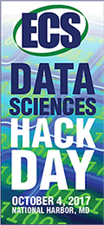
Matt Murbach, David Beck, and Dan Schwartz
eSciences Institute
Clean Energy Institute
Department of Chemical Engineering
University of Washington
Seattle, WA
Think Big: Lets start something that transforms how ECS scholars do work and move the field forward through collaboration and data sharing.

Slide 2
Who are you?
Do you use the command line for interacting with your files?
When you code, do you…
Use functions?
Use version control during development?
Work in a team? Use a programming style?
Write documentation or tests?
Do you know the Python scientific stack?
Numpy, scipy, pandas, …

Slide 3
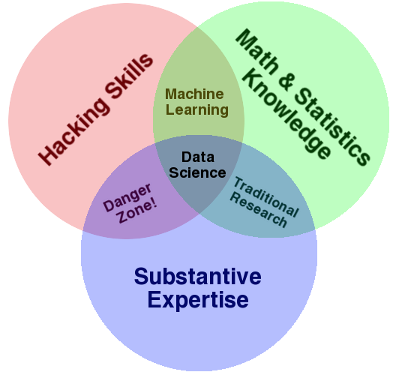
What is Data Science?
http://www.forbes.com/sites/gilpress/2013/05/28/a-very-short-history-of-data-science

Slide 4
What is Data Science?
Core Data Science Knowledge Areas
Data Management
How do you handle large amounts of data?
Visualization
How do you present and display oodles of data?
Statistics
How can you learn statistically meaningful things from your data?
Machine Learning
How can you use machines to discover structure and find meaning in your data?
http://www.forbes.com/sites/gilpress/2013/05/28/a-very-short-history-of-data-science

Slide 5
What is Data Science?
Core Data Science Knowledge Areas
Data Management
How do you handle large amounts of data?
Visualization
How do you present and display oodles of data?
Statistics
How can you learn statistically meaningful things from your data?
Machine Learning
How can you use machines to discover structure and find meaning in your data?
And the software tools we create and share to make all of this happen
http://www.forbes.com/sites/gilpress/2013/05/28/a-very-short-history-of-data-science

Slide 6
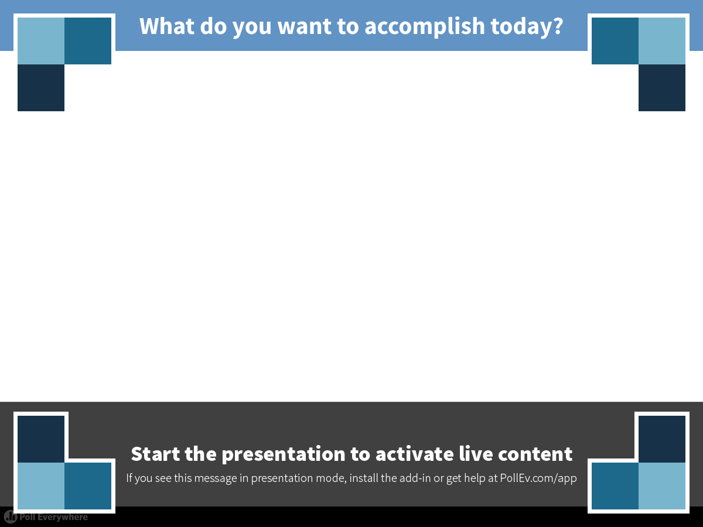
Notes:
What do you want to accomplish today?
https://www.polleverywhere.com/free_text_polls/jZmbv7Qfi5Uanmn

Slide 7
Megatrend #1: Funders are asking for new measures of research impact
Think: What are all the high impact research “products” we can generate together?
products
A list of: (i) up to five publications most closely related
to the proposed project; and (ii) up to five other
significant publications, whether or not related to the
proposed project.
products
First announced, NSF Grant Proposal Guide NSF 13-1
Notes:
7

Slide 8
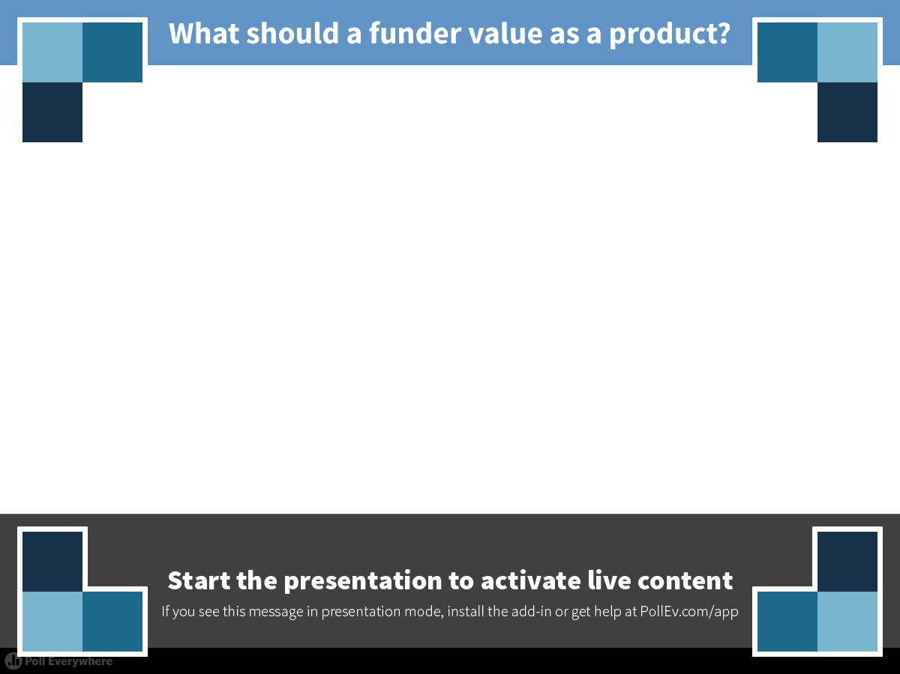
Notes:
What should a funder value as a product?
https://www.polleverywhere.com/free_text_polls/KQIsOCgZKy8q6tJ

Slide 9
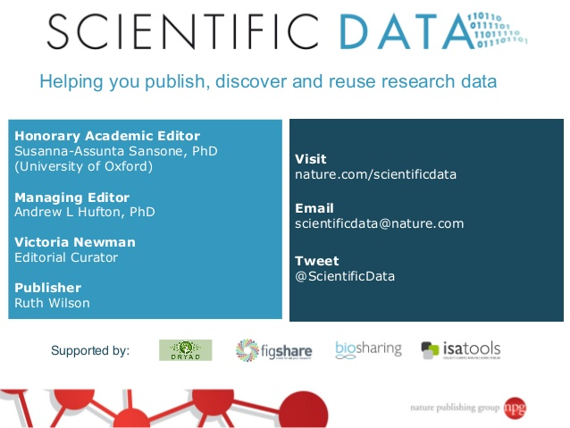

Nature publishing thinks some datasets are important research products
Notes:
-give sample data set publications

Slide 10
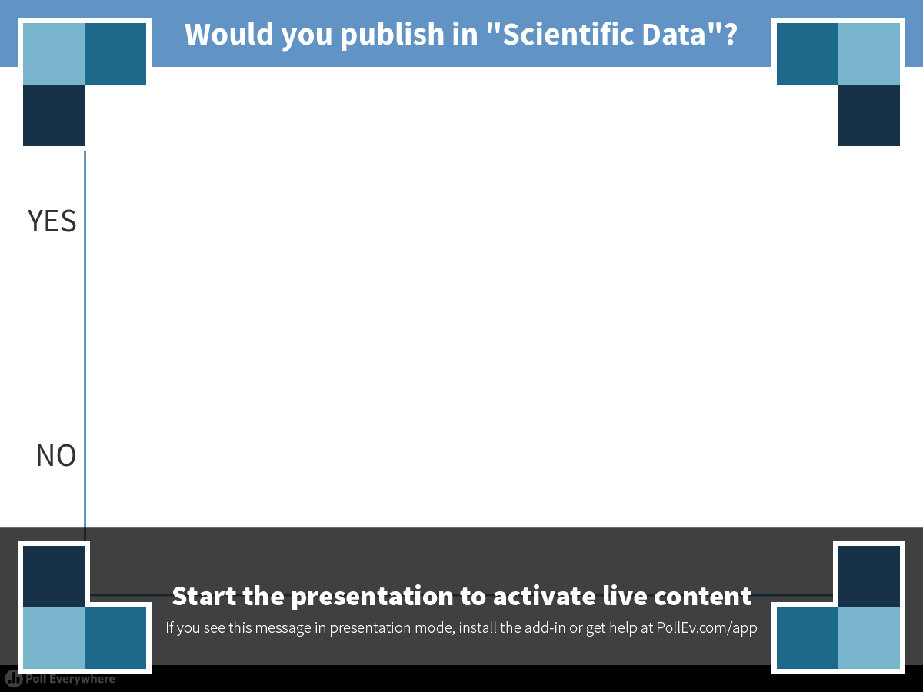
Notes:
Would you publish in "Scientific Data"?
https://www.polleverywhere.com/multiple_choice_polls/HJh0qn8cJ2VFl8v

Slide 11

Megatrend #2: Impact of open source software
Berkeley Software Distribution (BSD) --- 1970’s Unix
BSD➔386BSD➔FreeBSD...MacOS➔iOS
Notes:
11
- expand on FEFF impact
- Rosetta Commons, licensing revenues to build community of developers.

Slide 12
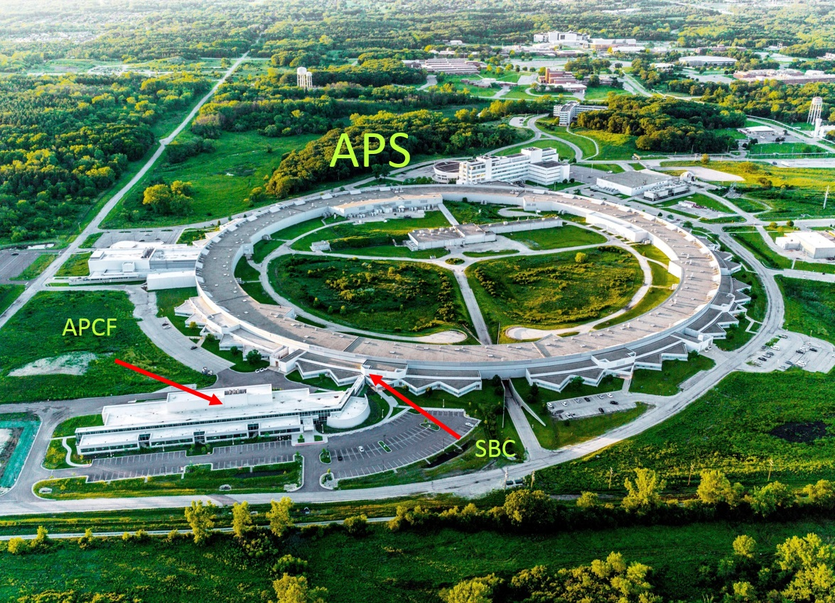
Megatrend #2: Impact of open source software
FEFF Project – ab initio analysis for XAFS spectra
John J. Rehr, Physics
Think: Can shared software tools accelerate your research productivity?
Notes:
12
- expand on FEFF impact
- Rosetta Commons, licensing revenues to build community of developers.

Slide 13
Software is a research product
Hack Day has a DOI and is a research product!
JOSS produces “software” papers with open peer review?
Notes:
- example from JOSS
-#3300 to make an NPG paper open from day 1

Slide 14
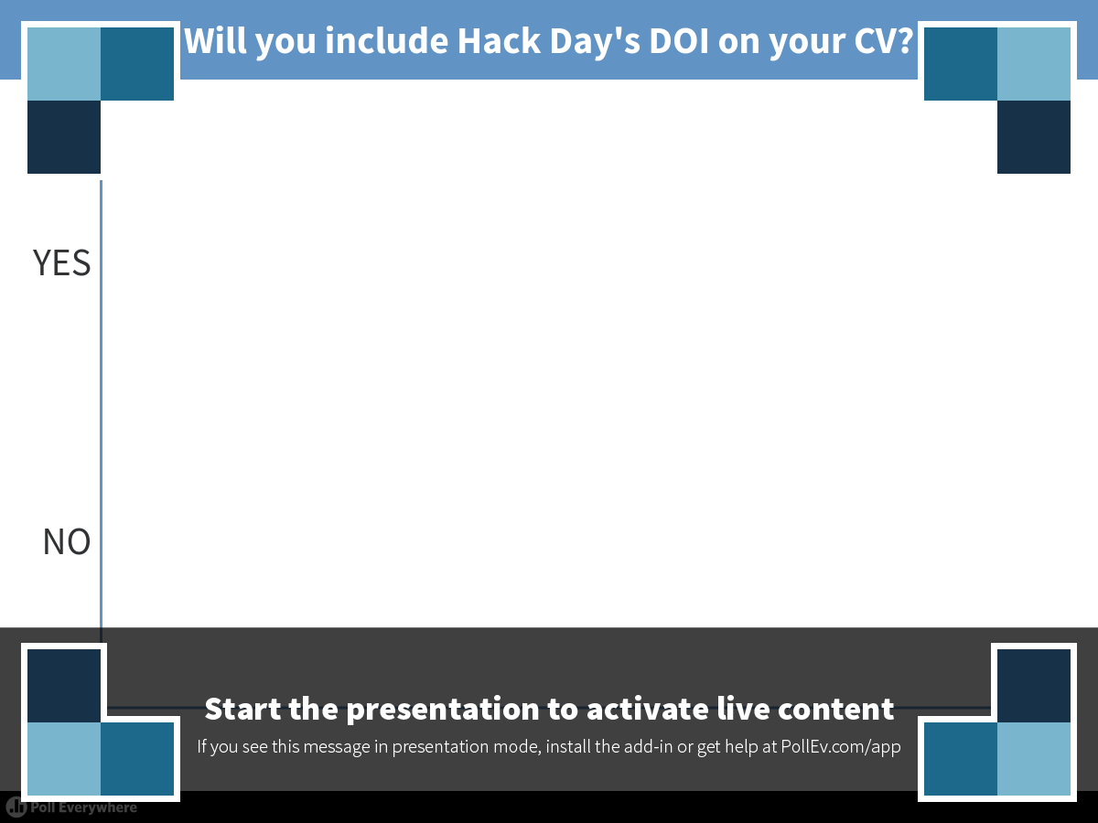
Notes:
Will you include Hack Day's DOI on your CV?
https://www.polleverywhere.com/multiple_choice_polls/75TQSit4fNidbpP

Slide 15
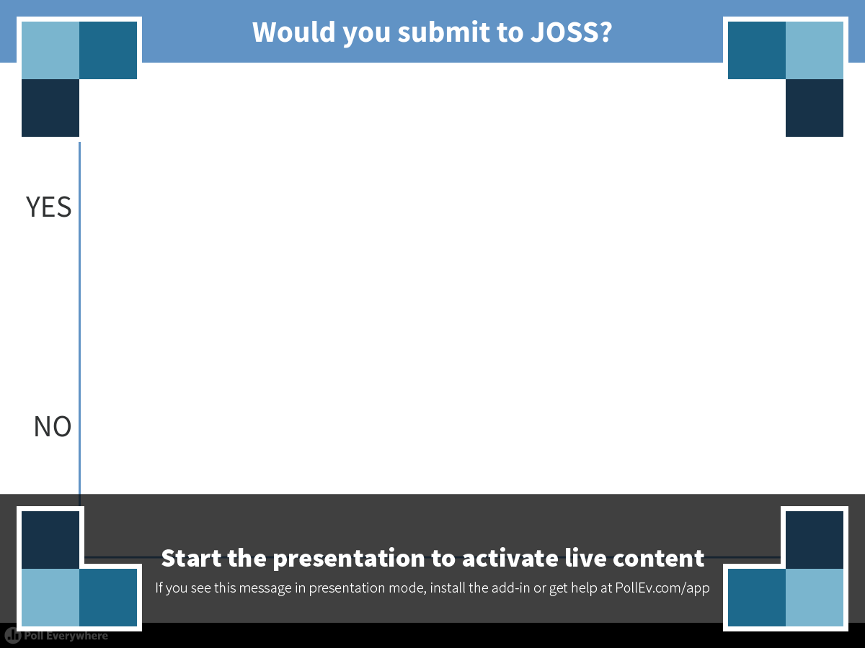
Notes:
Would you submit to JOSS?
https://www.polleverywhere.com/multiple_choice_polls/2bAM006aRgON3K0

Slide 16


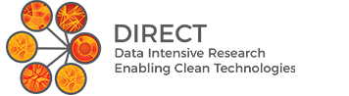

Megatrend #3: Explosive job growth in software publishing, informatics
Ph.D. with Advanced Data Science Option
Ph.D. with Molecular Data Science Option
Notes:
16

Slide 17
Employment Projections for Chemical Engineers
2024
ChemE
Employment
(NAICS 54)
Services
+ 15%
2024
ChemE
Employment
(NAICS 31-33)
Manufacturing
- 7%
2024
ChemE
Employment
(NAICS 54)
Services
+ 15%
#1 Basic Chemicals Man.
#2 Polymer Man.
#1 Engineering Services
#2 R&D Services
U.S. Bureau of Labor Statistics, http://data.bls.gov/projections/nationalMatrixHome?ioType=o
U.S. Bureau of Labor Statistics, http://data.bls.gov/projections/nationalMatrixHome?ioType=o
Notes:
17

Slide 18
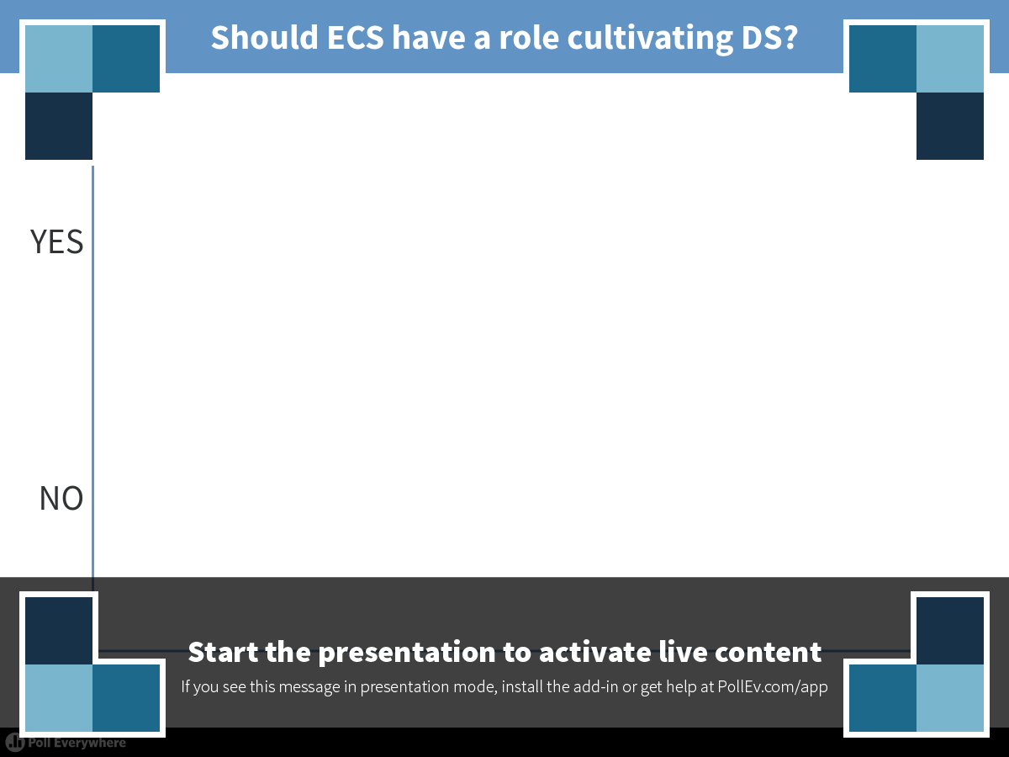
Notes:
Should ECS have a role cultivating DS?
https://www.polleverywhere.com/multiple_choice_polls/o6C772vQCceRu56

Slide 19

ECS has joined the Center for Open Science
COS provides ECS access to Open Source tools for sharing data, sharing software, and building a data science community

Slide 20
ECS National Harbor meeting will feature data sciences!
Sunday, October 1
ECS OpenCon Satellite Event
Wednesday, October 4
ECS Data Sciences Hack Day

